Slide 1

Model Evaluation

Slide 2
Objectives
Describe data model refinement techniques
Explain overfitting, underfitting and model selection
Model Evaluation

Slide 3
Model Evaluation and Refinement
Model evaluation tells us how our model performs in the real world
In-sample evaluation tells us how well our model will fit the data used to train it
Problem:
  It does not tell us how well the trained model can be used to predict new data
Solution:
  In-sample data or training data
  Out of sample evaluation or test set
Model Evaluation

Slide 4
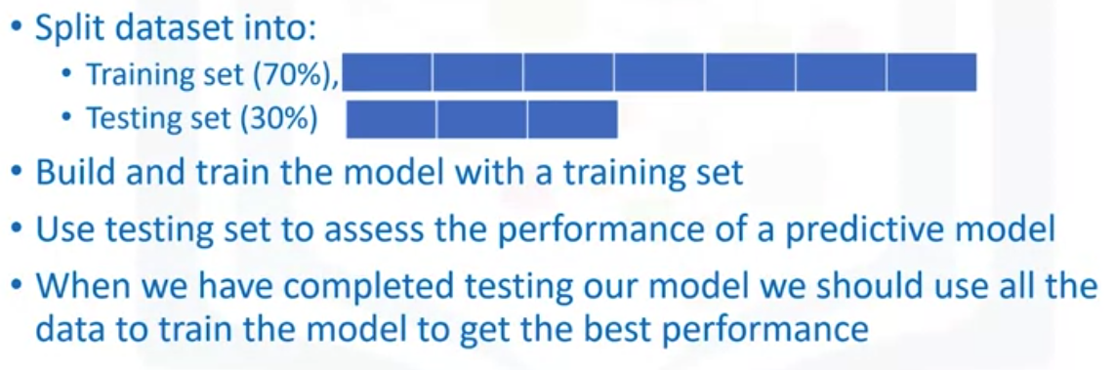
Model Evaluation and Refinement
Model Evaluation

Slide 5
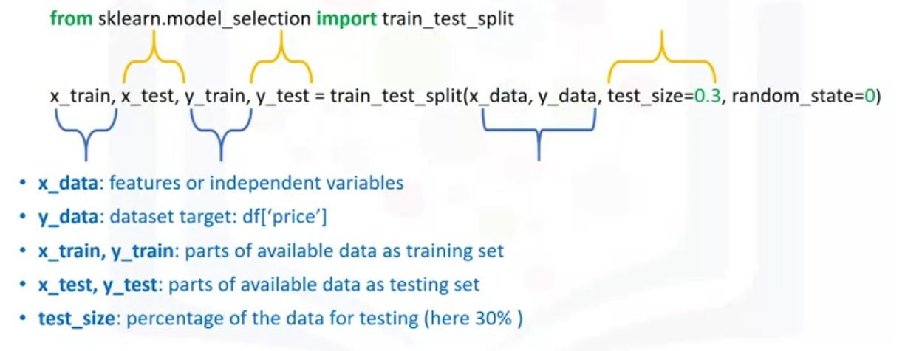
Model Evaluation and Refinement
Split data into random train and test subsets
Model Evaluation

Slide 6
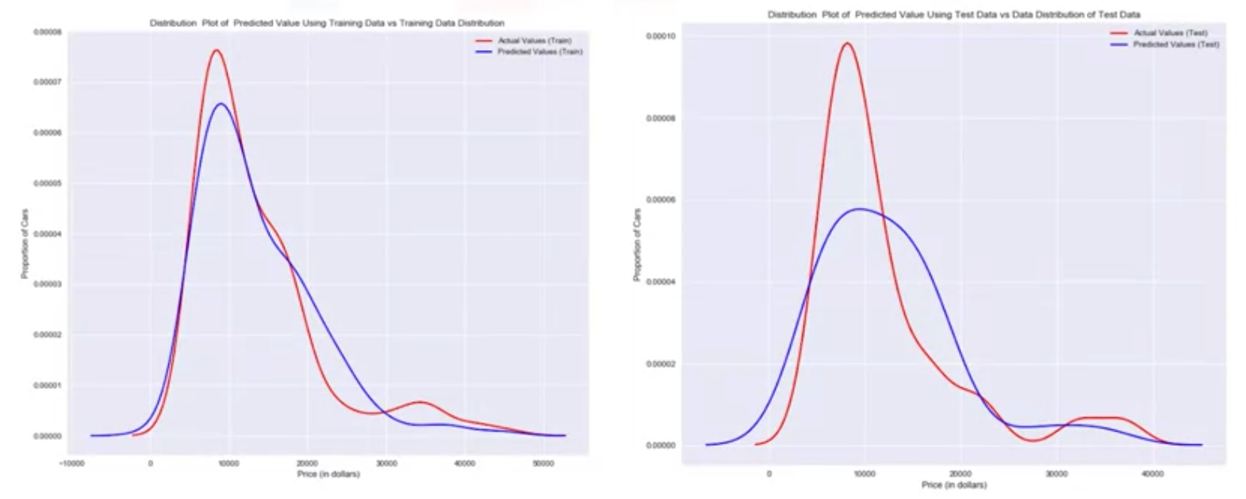
Model Evaluation and Refinement
Generalization error
Model Evaluation

Slide 7
Model Evaluation and Refinement
Lot of data for training, gives us an accurate means of determining how well our model will perform in the real world.
But the precision of the performance will be low.
Model Evaluation

Slide 8
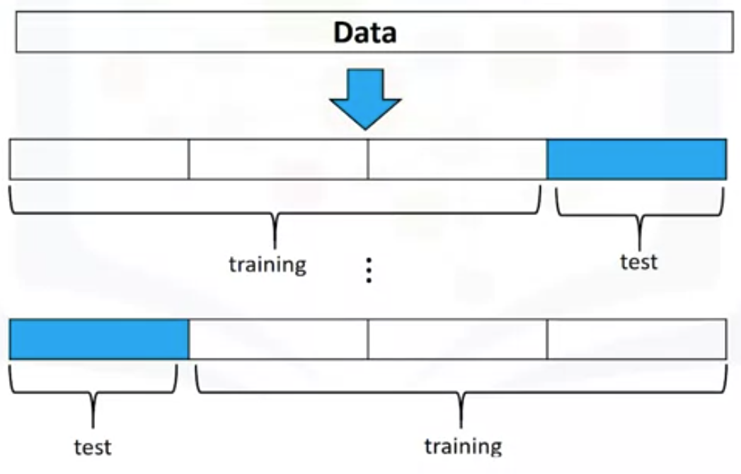
Model Evaluation and Refinement
Cross validation
  Most common out of sample evaluation metrics
  More effective use of data( each observation is used for both training and testing)
  We use the average results as the estimate of out-of-sample error.
Model Evaluation

Slide 9
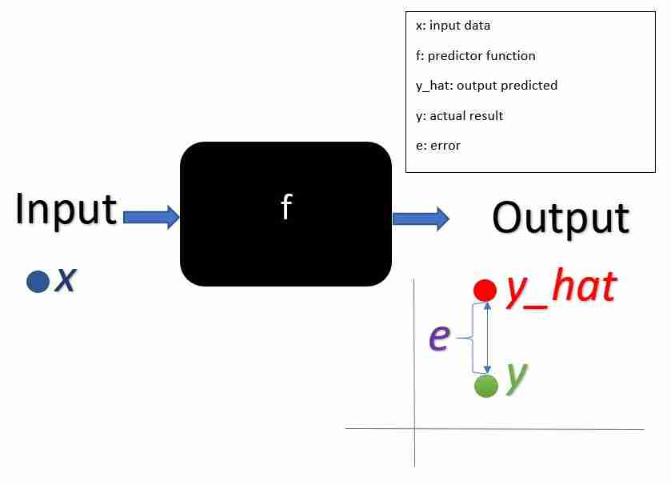
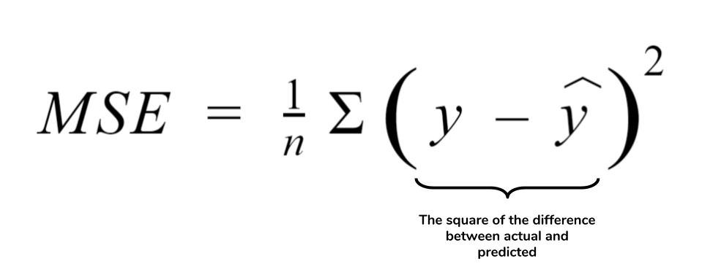
Overfitting, Underfitting and Model Selection
Model Evaluation

Slide 10
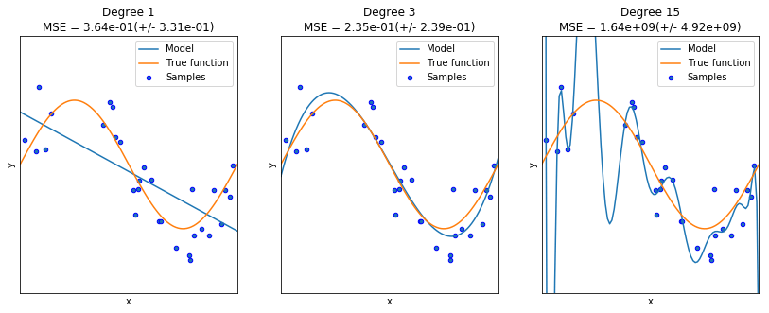
Overfitting, Underfitting and Model Selection
Model Evaluation

Slide 11
Overfitting, Underfitting and Model Selection
How to over:
  Overfitting
  Underfitting
Model Evaluation

Slide 12
Summary
Describe data model refinement techniques
Explain overfitting, underfitting and model selection
Model Evaluation

Slide 13
Q & A
Model Evaluation

